Slide 1
Angular Upskilling Program
Angular Router

Slide 2

Angular Router
Router is needed in order to share a web application state to another user.
If a routing mechanism wouldn’t be present on the application, sharing
the URL to another client would cause undefined behaviour.
When the URL is accessed the application needs to know what products, smartphone and
page=2 means.
In this case:
products might be the path used for loading the ProductsComponent;
smartphones could be some filtering mechanism by using the path parameter;
page=2 could tell the number of the page from the products list to be loaded.

Slide 3
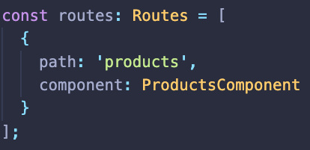
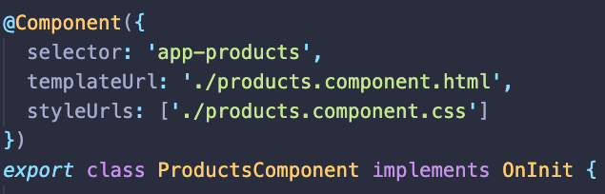
How Angular Router works?
Analyzes the URL entered in the browser: https://my-app.com/products
Looks for a router configuration for that specific path:
Instantiate the component mentioned in the configuration
Renders the component’s template in router’s content container.

Slide 4
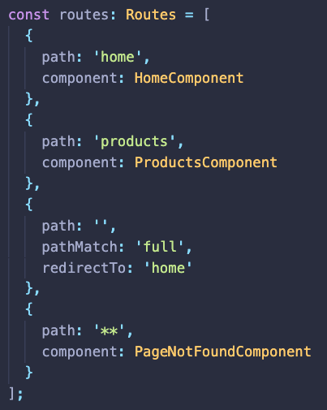
Angular Router - Configuration
Router’s path configuration should be setup in a constant variable of type Routes (Route[]), where each route is defined with a path and component.
‘**’ path is used as a wild card for an URL that is not matching any path from the configuration.
This configuration is passed to the RouterModule by using the forRoot method.
To avoid Router path misses, redirectTo entries are used in the Router configuration with the following options:
pathMatch: ‘full’ – If the complete path that does not match the route is matching the path value;
pathMatch: ‘prefix’ – If the beginning path that does not match the route is matching the path value;

Slide 5
Angular Router – Guards
There are a few scenarios where a component won’t be loaded immediately or there are a list of conditions that needs to be checked in order to load a route.
Angular provides handlers for each of these scenarios by adding the following option in a Route configuration:
canActivate: Mediates navigation to a route.
canActivateChild: Mediates navigation to a child route.
canDeactivate: Mediates navigation away from the current route.
resolve: Performs route data retrieval before the route is activated.
canLoad: Mediates navigation to a feature module that is loaded asynchronously.

Slide 6
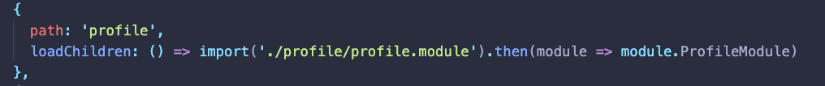
Angular Router – Lazy Loaded Modules
The most important part when delivering the frontend part of an application is the bundle size of the output Jascript, CSS and HTML.
Usually an application contains more than one Angular Module.
Ideally would be to deliver on the first load of the application the minimum amount of code needed to display the Application Shell and load the rest of the modules in a Lazy Approach;
This is made possible by using the webpack module bundler

Slide 7
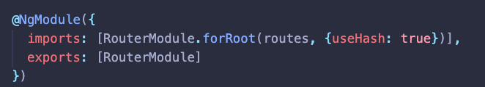
Angular Router – Strategies
After building the Angular application the bundles must be served from an HTTP server.
Each route defined in the configuration must be mapped accordingly but there will be conflicts between the frontend and the backend because the server is not aware of these routes.
In order to prevent any conflict it is recommended to modify the routing strategy on the client application so no accidentally request is sent to the server, by adding th # symbol before the root path

Slide 8


